Slide 1
Thermal RGB
Presentation
Jacob Stafford, Bright Lu, Steven Shreve, Fuli Wang

Slide 2
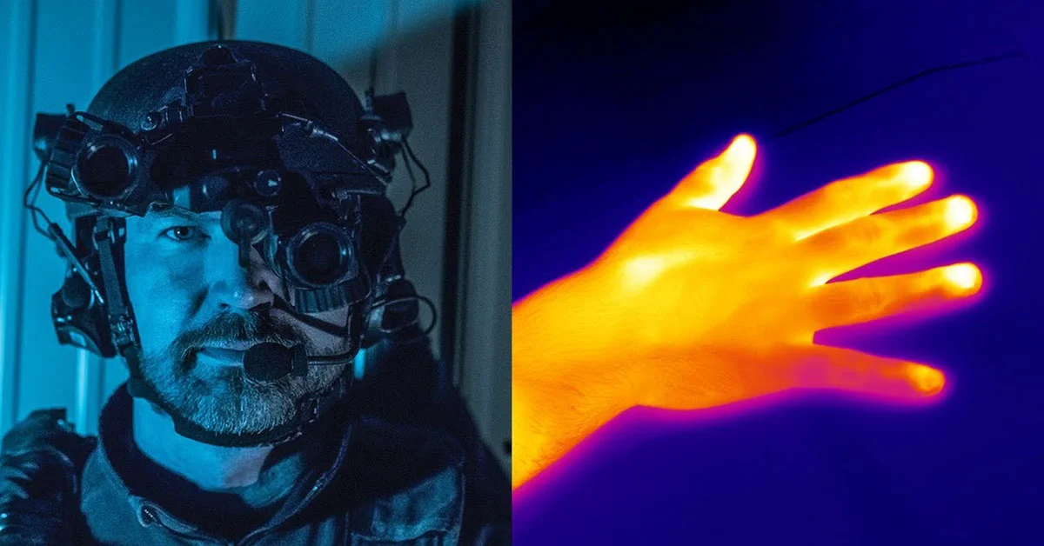
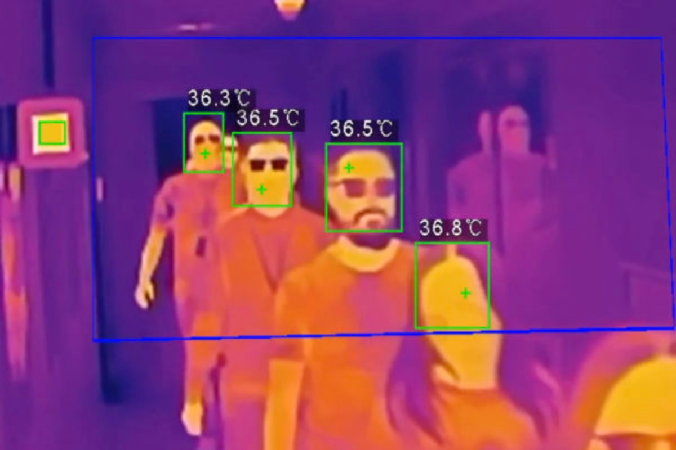
Problem Statement
Need for clear thermal images
People in certain high stakes professions need clear thermal images
RGB provides best clarity
Thermal adds additional information for our information age

Slide 3
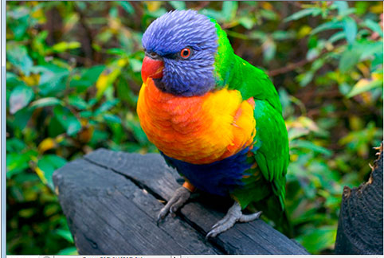
Thermal vs. RGB
Thermal: Detects infrared and reproduces image
RGB: Uses red, blue and green layers to reproduce images that can easily be recognized by people

Slide 4
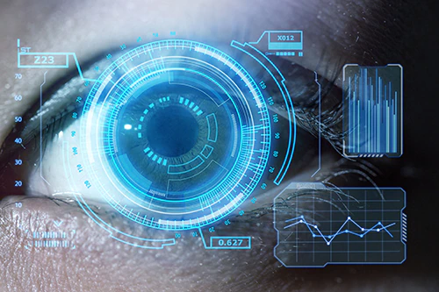
Computer Vision (i.e the big picture)
Image processing is a very applicable tool
Relies on Recognition, Reorganization and Reconstruction
Our focus is on the reconstruction
Using these principles we can create “computer vision”

Slide 5
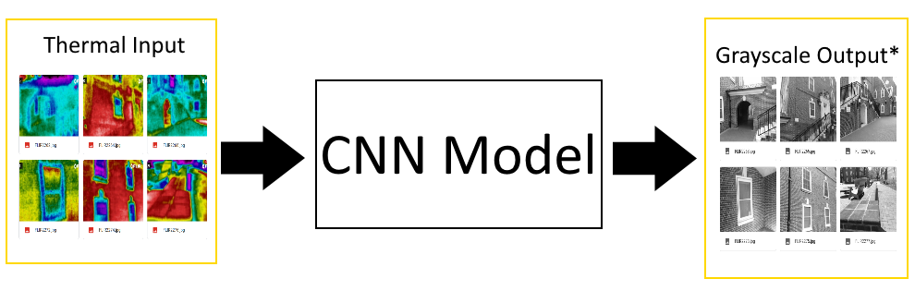
1. Data Acquisition

Slide 6
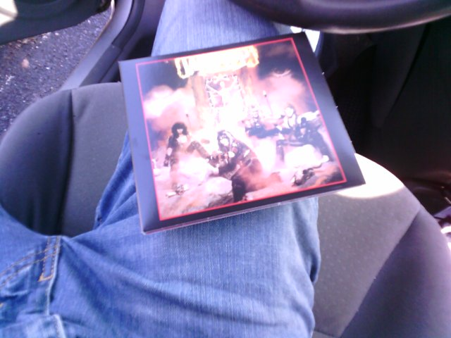
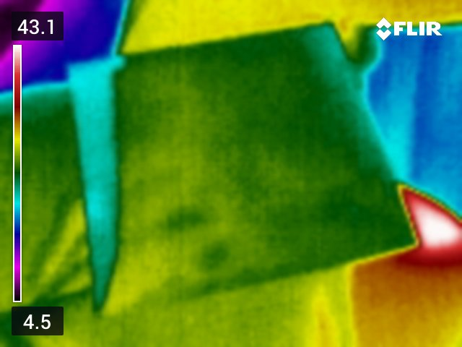
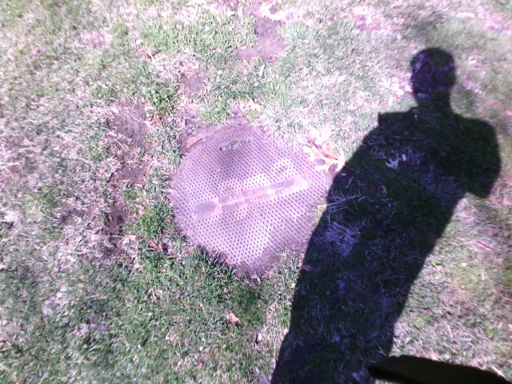
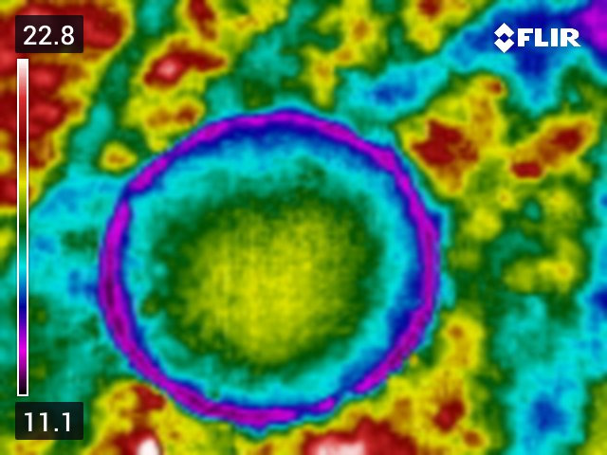
Started out with a lot of things
Initially started with images of whatever could be photographed
Initial algorithm had trouble processing the different variety of images
Needed to make more standardized data set

Slide 7
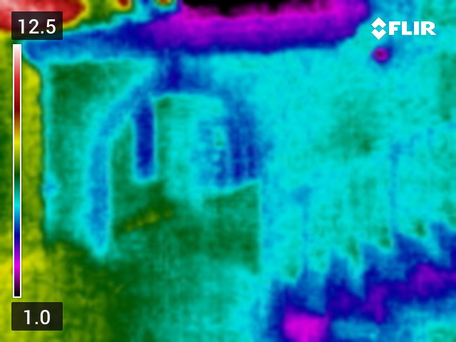
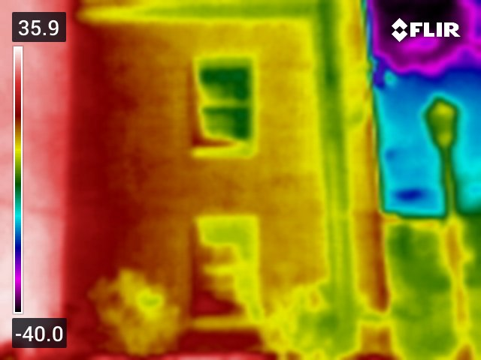
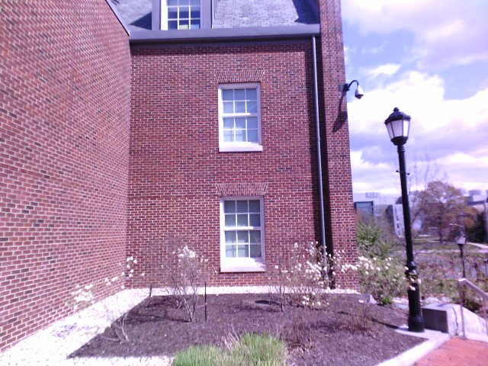
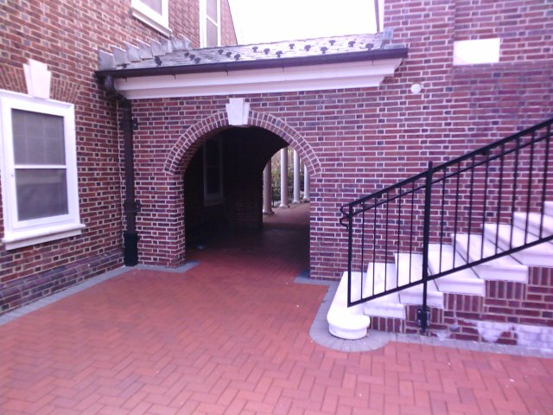
Move to Brick Buildings
Easy to acquire data
Similar in Color/Shape
Differences in temp due to light
Collected 1000 building images

Slide 8
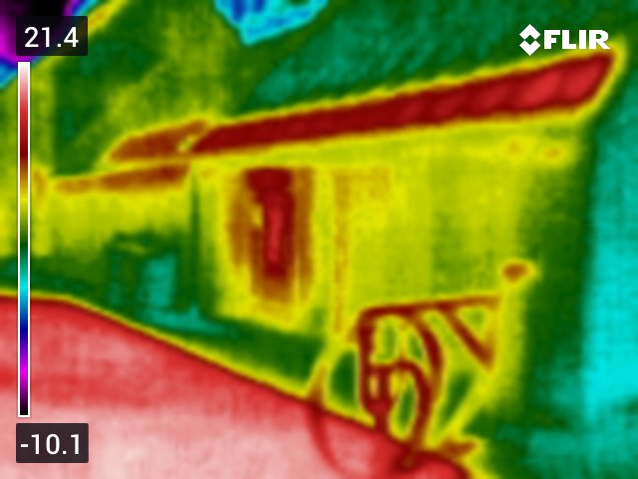
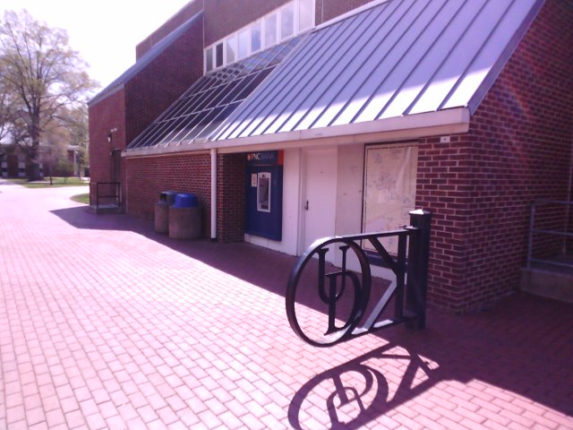
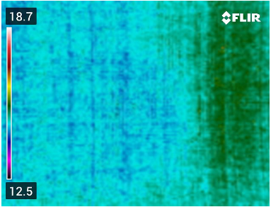
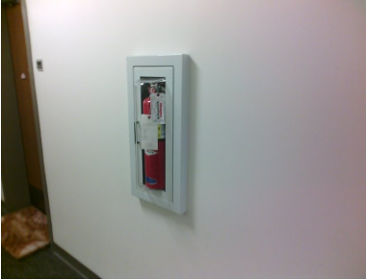
Issues with Thermal Images
Shadows
Inside image = mono-temp = objects disappear

Slide 9
Pre-processing of Images
Resizing RGB to correct for Thermal zoom
Grayscaling of RGB
Resize images to all be 256x256

Slide 10
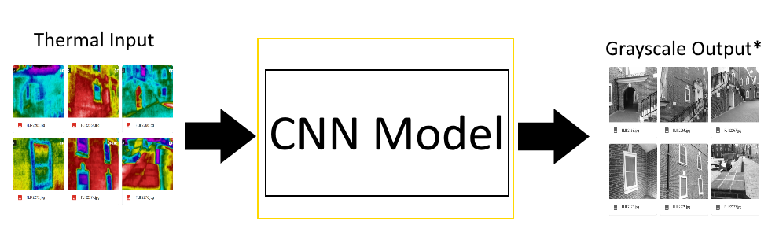
2. Algorithm Model

Slide 11
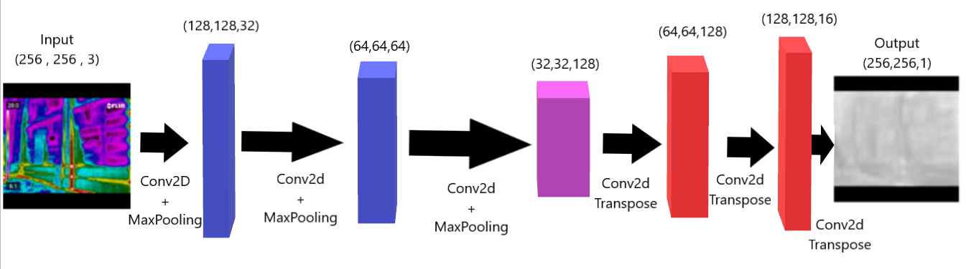
Block Model of Algorithm

Slide 12
Encoder and Decoder
3 layers each
More did not improve
Same size output as input

Slide 13
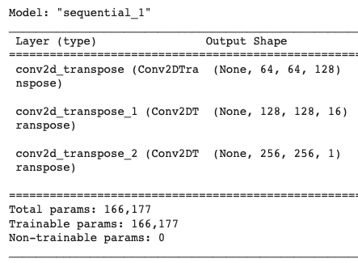
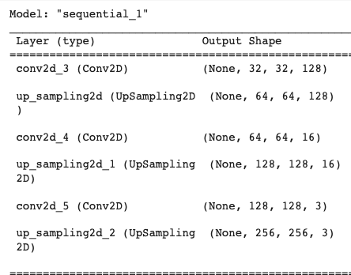
New Decoder
3 layers each
Conv Transposed acts as counter to Conv

Slide 14
Convolution
Conv Encoder, Conv Transposed Decoder
Conv Compress + detects, Conv Transposed Expands
Same size output as input

Slide 15
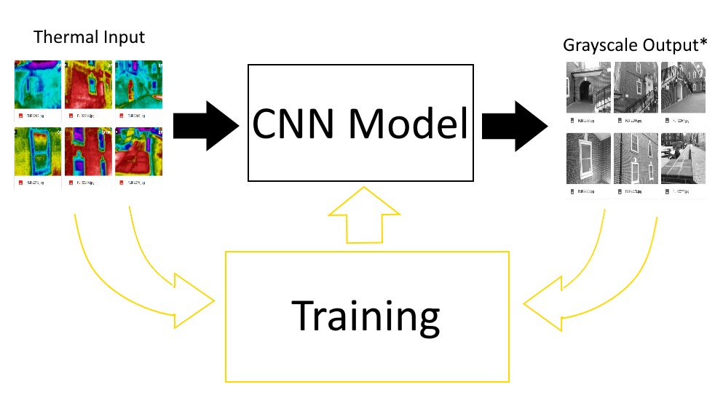
3. Training

Slide 16
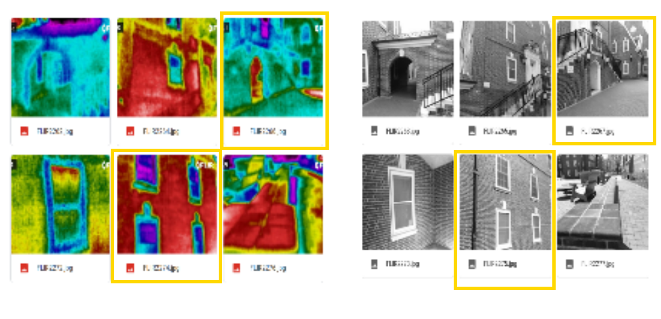
Training / Testing Split
Training to Testing Ratio (80/20)
Random Split, but same for every run

Slide 17
Loss Model
Changed from MSE to SSIM
MSE minimize, SSIM maximum (1-SSIM = minimize)
SSIM: Structural Similarity Index
SSIM: luminance, contrast, and structure

Slide 18
Training Variations
Batch Size, ~10 right #
Gray to Gray, Thermal to Gray, Wide Set to Gray

Slide 19
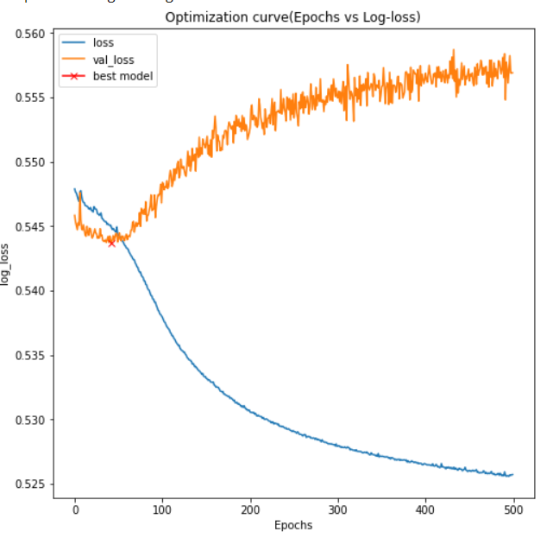
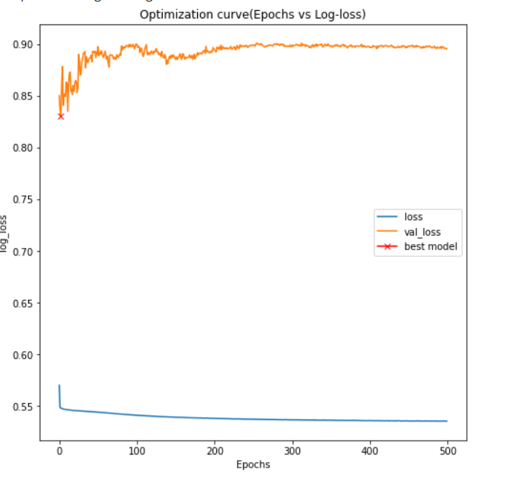
Issues with Training
Overfitting
Randomness

Slide 20
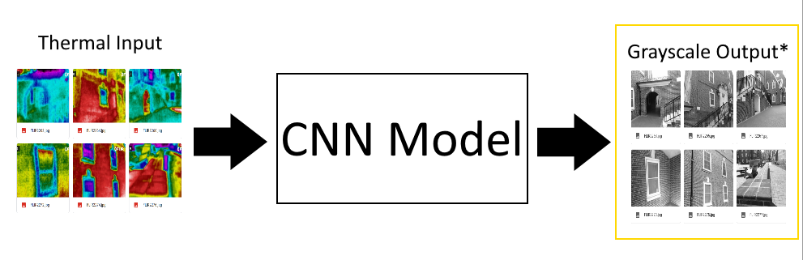
4. Results

Slide 21
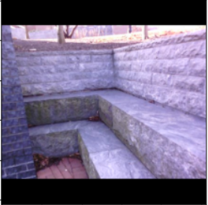
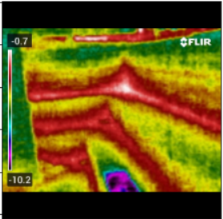

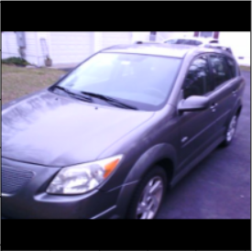
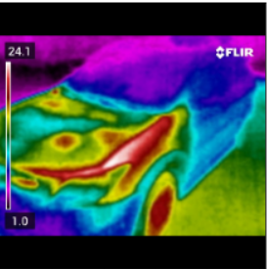
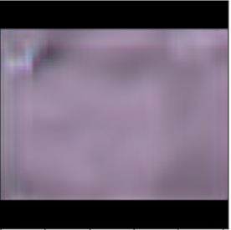
Preliminary Results
Input RGB
Input Thermal
Output RGB
Discernable shape
Improvements with decreased MSE value
Artifacts in output
Mono-colored output

Slide 22
Improvements
Improved decoder model
Simple convolution upsampling -> transpose
Increased data pool
Further data collection
Rotated images
Pivot in data set
Buildings vs. random objects
Changed loss model from MSE to SSIM
Grayscaling

Slide 23
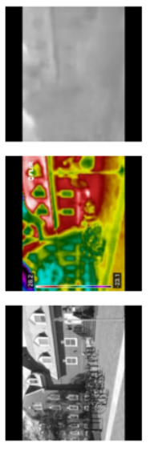
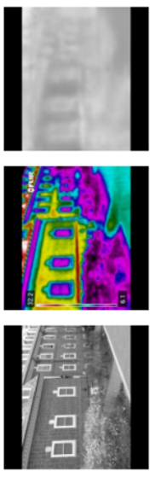
Improved Results
Input Gray
Input Thermal
Output Gray
Pivot to focus on edge detection
Increase in perceptibility
Artifacts less visible
Decrease in practicality

Slide 24
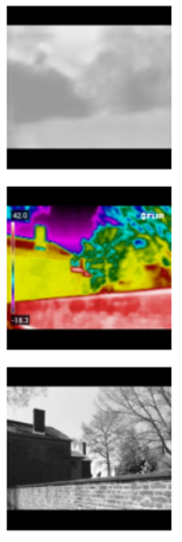
Future Exploration
Higher resolution thermal camera
More data for model
Investigate less varied data sets
Controlled environments
Output image post-processing
Deblurring
Contrasting
Thermal range as input parameter

Slide 25
Challenges of the Project as Whole
Limited body of research
Certain images had objects which blended into the background
Didn’t always have sufficient input
Size and shape altered between RGB and Thermal images
Source: https://github.com/topics/thermal-imaging

Slide 26
Self-Reflections
Save everything, even the bad stuff
There’s never enough data
Machine learning can’t do magic tricks

Slide 27
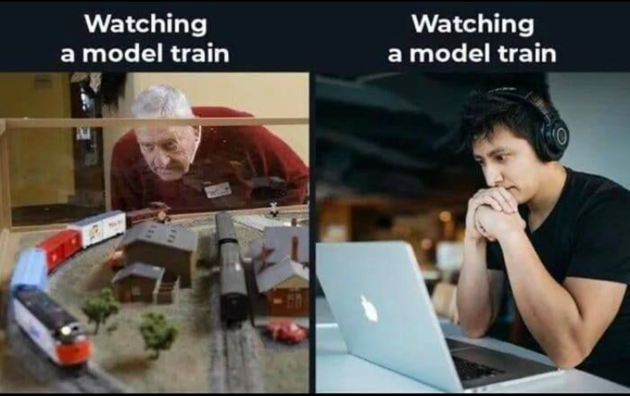
Thank You for Your Time

